Slide 1
GIS 1: a very basic introduction
By Vanessa Arias Casillas (Graduate Fellow)

Slide 2
Agenda
What is GIS?
Classic ArcGIS online overview
Base and Layers
Analysis
Edits
Save and Send to New ArcGIS Online
Print and Share
Endnotes

Slide 3
Goal
Navigate ArcGIS Online
Make a simple map
Run simple analysis with the data on your map
Show your map your group or organization
Make a PDF print for presentations and reports

Slide 4
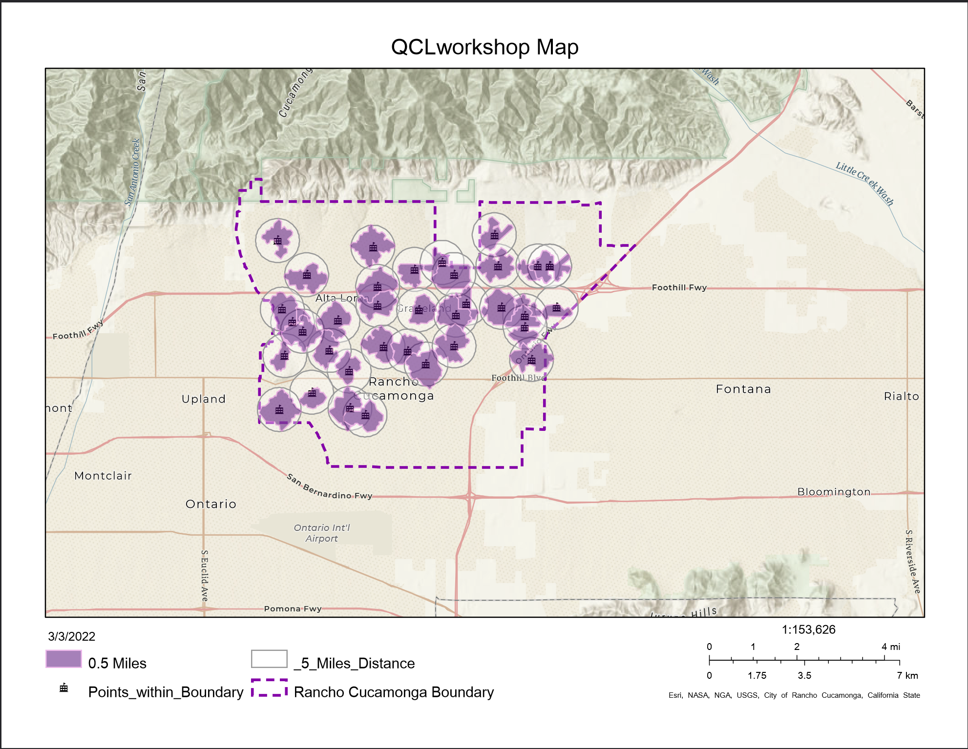

Slide 5
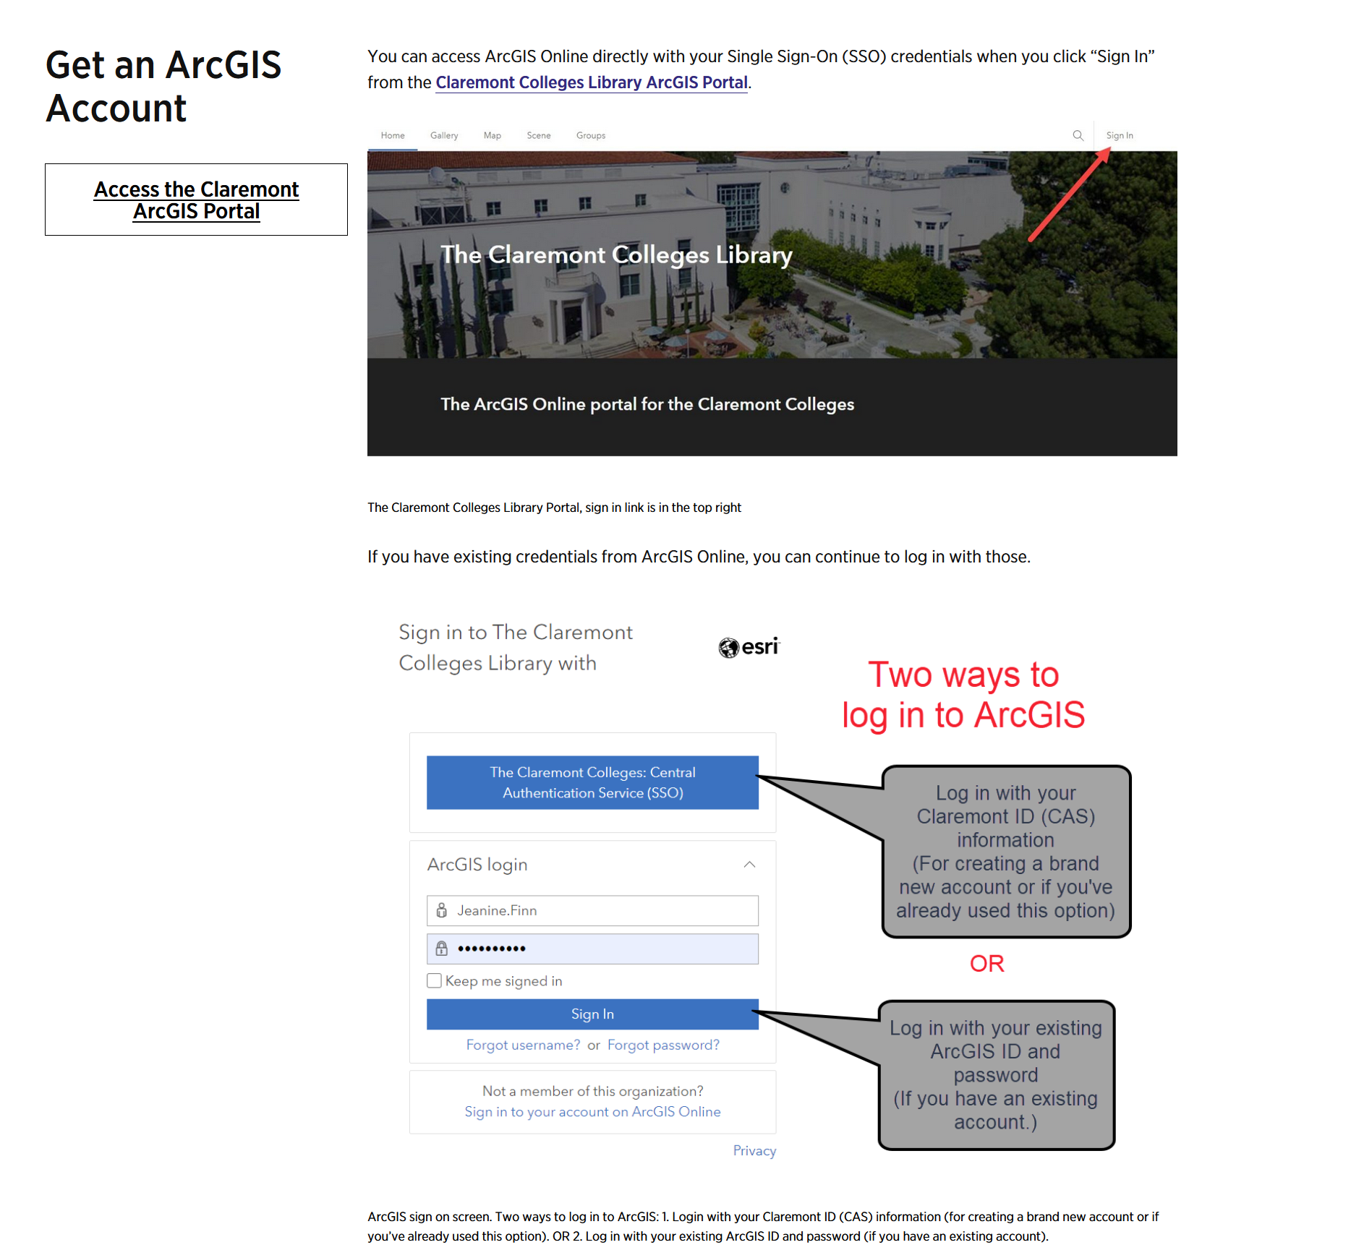
CMC – ArcGIS

Slide 6
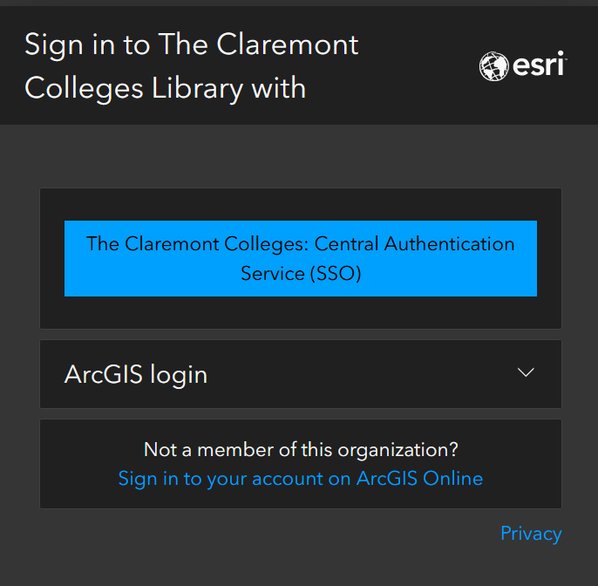
Organization and login

Slide 7

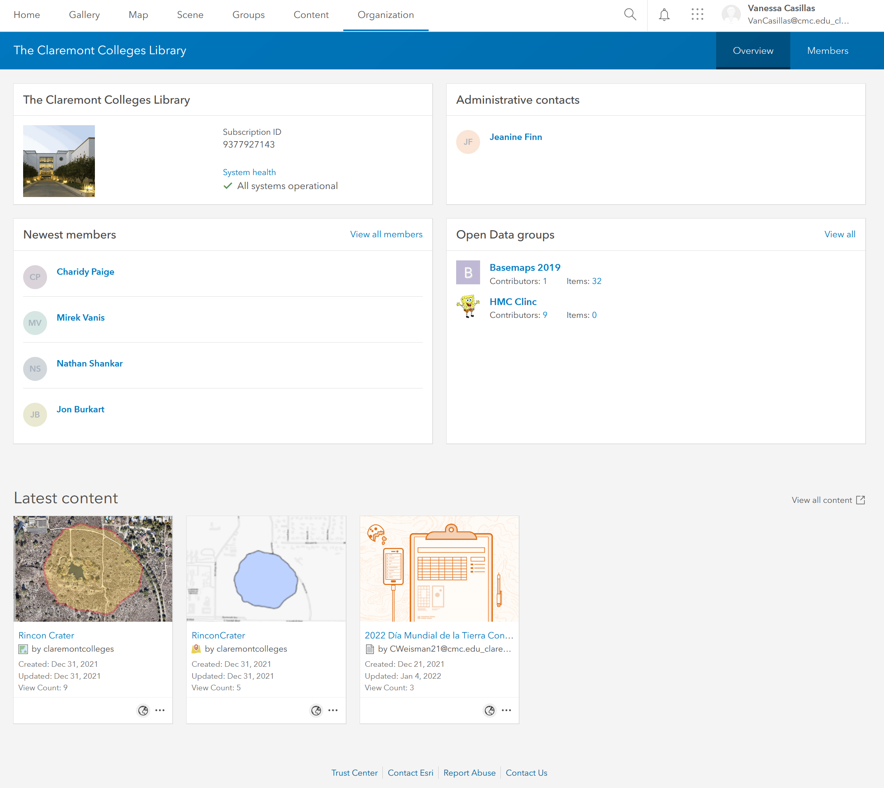
Home view

Slide 8
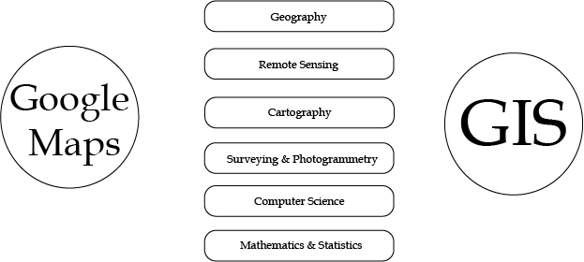
First Question people think of when learning GIS: GOOGLE MAPS – Is it GIS?
https://www.quora.com/Is-Google-Maps-considered-a-geographic-information-system

Slide 9
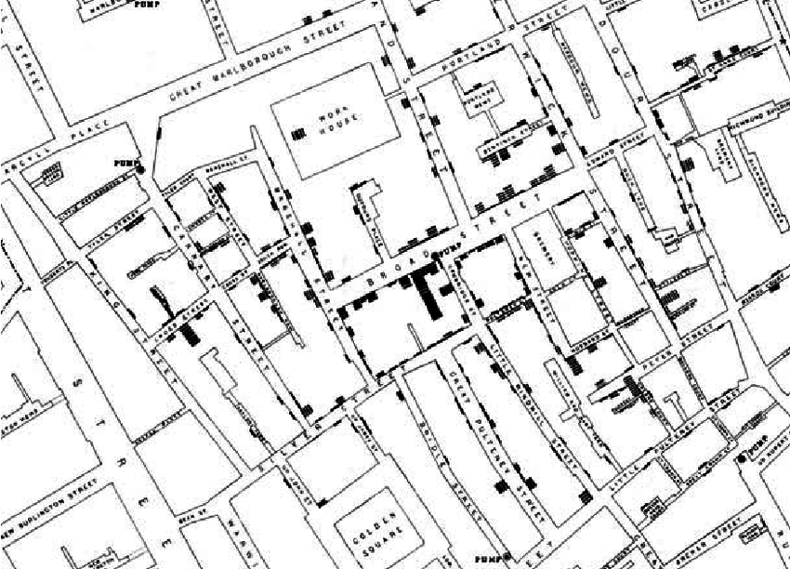
GIS? Quick Overview
GIS: Geographic Information Systems
Storing, retrieving, comparing spatial data
ESRI: Environmental Science Research Institute (The Science of Where)
Jack Dangermond Redlands
1854 Cholera Epidemic – London: Dr. John Snow
Mapped cholera deaths
Determined water pump source
https://www.researchgate.net/figure/John-Snows-famous-map-of-the-1854-Broad-Street-epidemic-attempted-to-positively_fig1_220144184

Slide 10
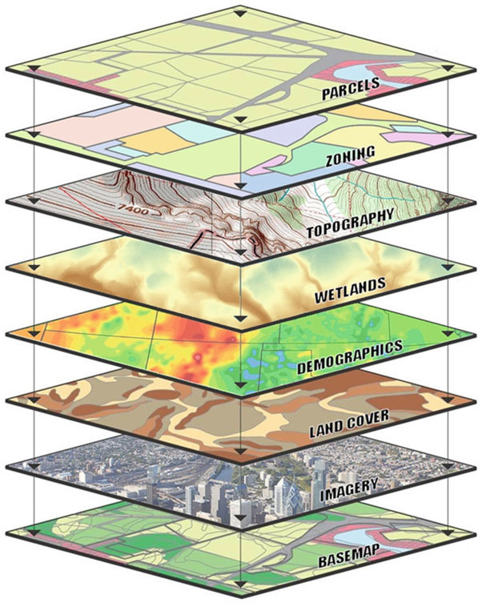
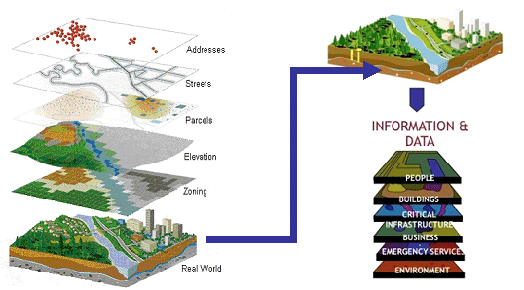
Layers and Layers and Layers
Shukla, Yogita. (2012). Innovative Geospatial Solutions - Key to India's Transport Infrastrcuture.
Kolios, Stavros & Vorobev, Andrei & Vorobeva, Gulnara & Stylios, Chrysostomos. (2017). WebGIS Applications for Weather, Marine, and Atmospheric Environments. 10.1007/978-3-319-53086-4_2.

Slide 11
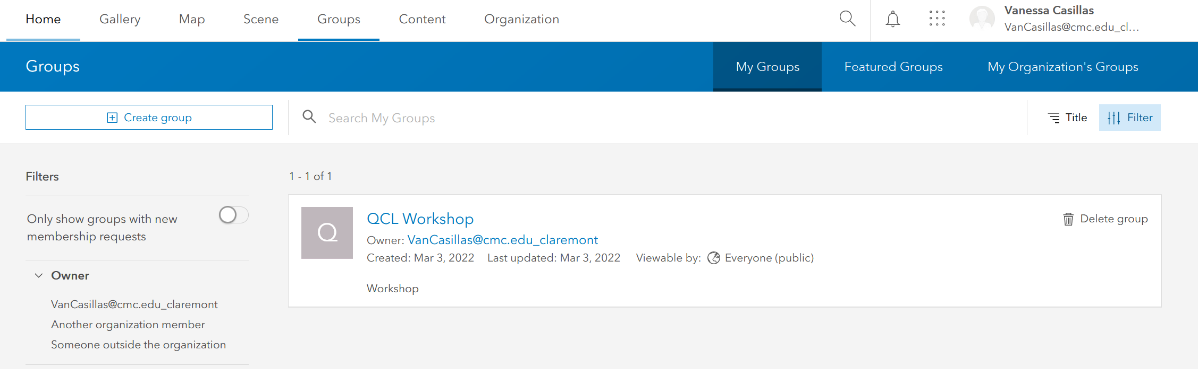
Groups – add yourself

Slide 12

Planning a Map: a simple map
Problem – why are we making a map?
Data – what layers do we need?
Analysis – what layers do we need to adjust or make?
Edits – who is looking at the map?
Results – does it tell a visual story?

Slide 13

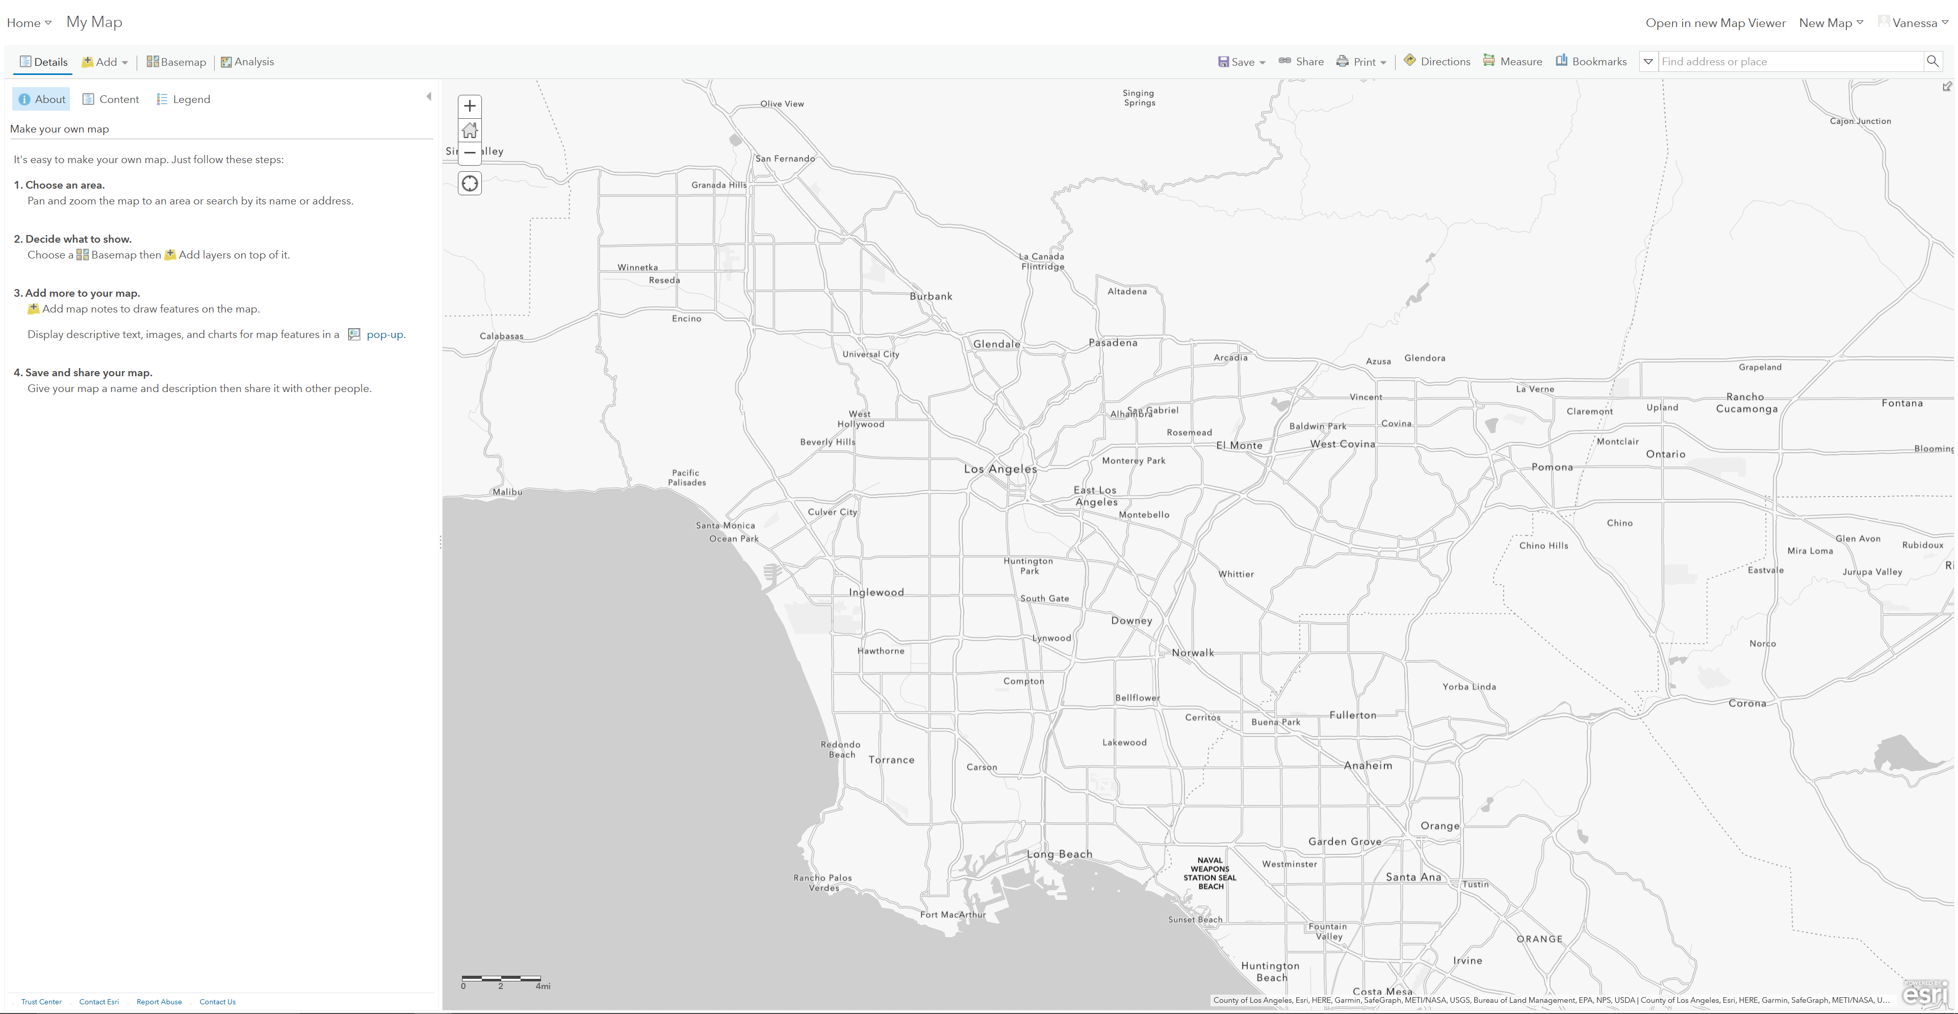
Classic ArcGIS

Slide 14
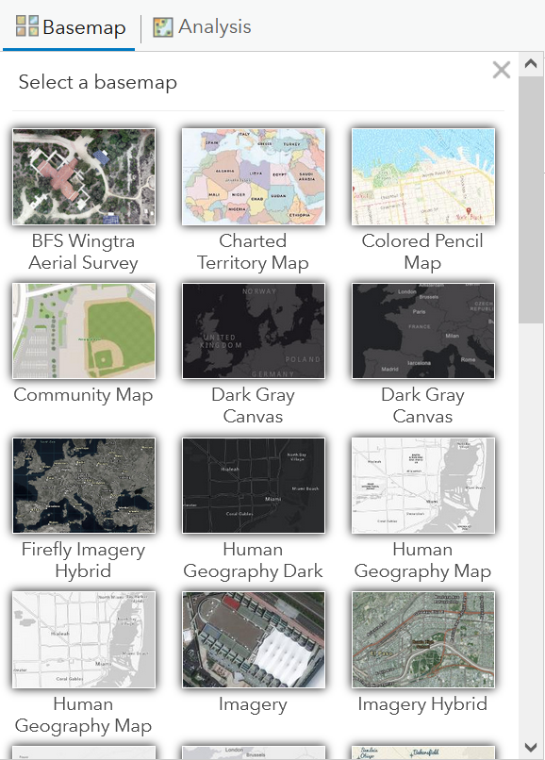
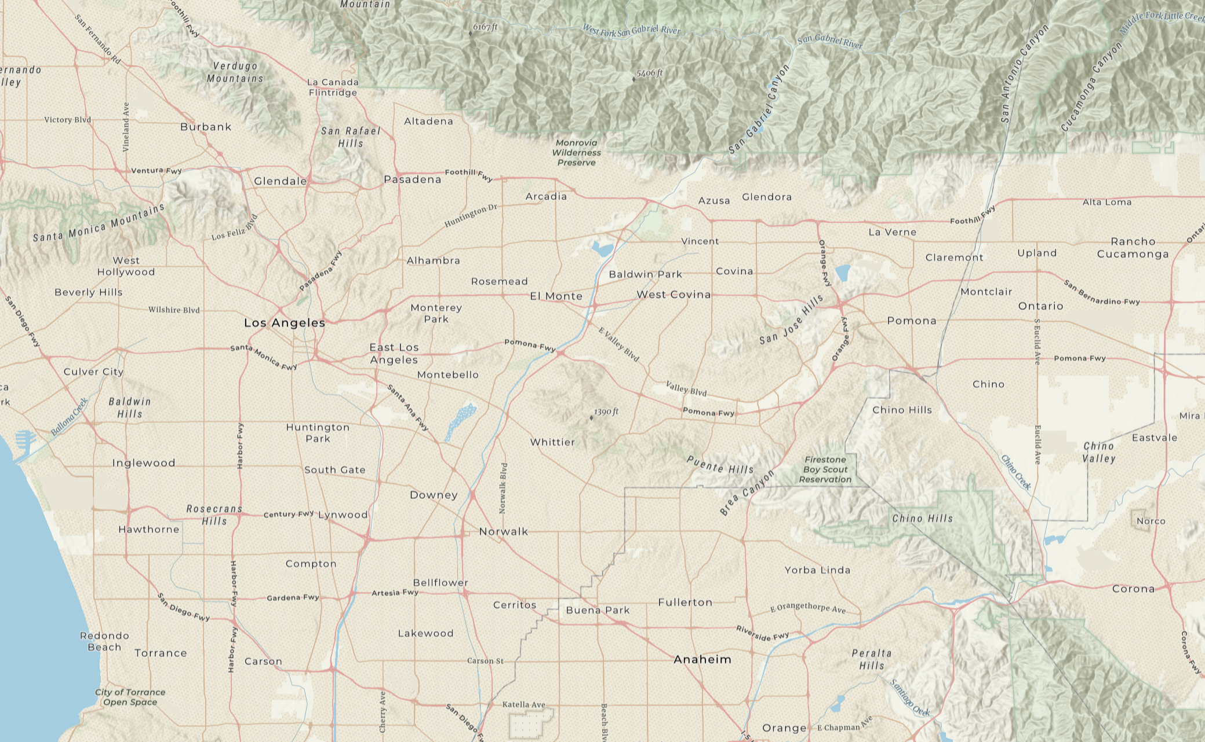
Base Maps

Slide 15
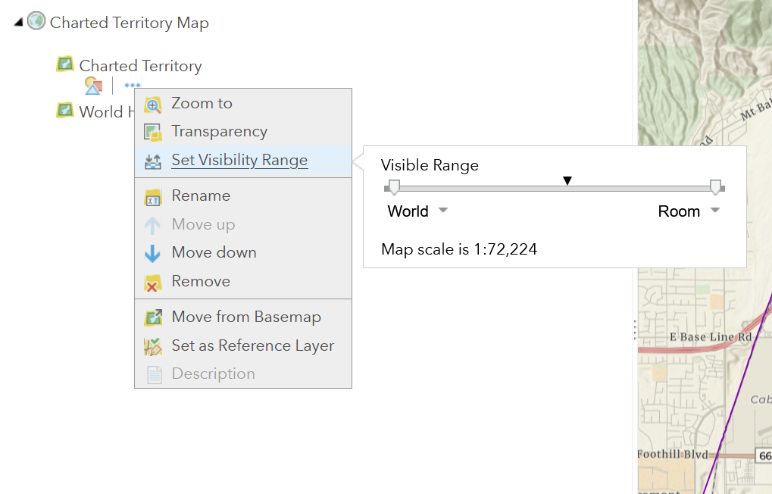
Base map
Overview

Slide 16
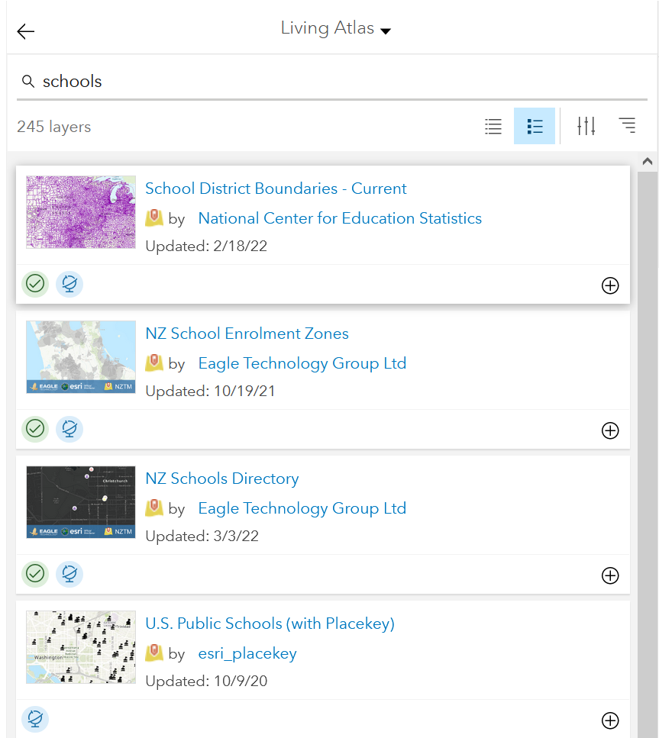
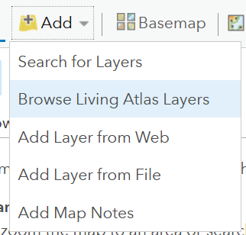
Living Atlas
Layers and layers and layers

Slide 17
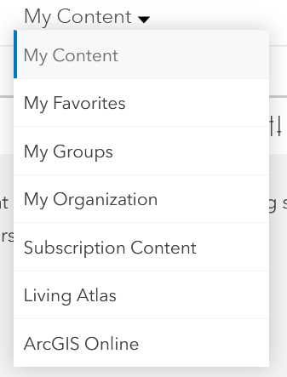
My Content

Slide 18
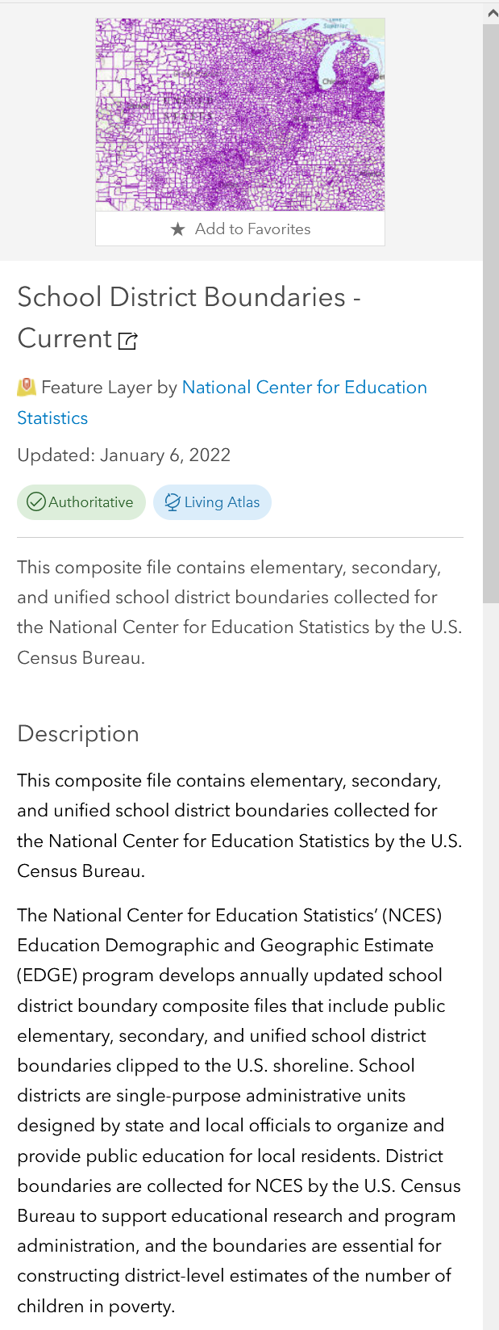
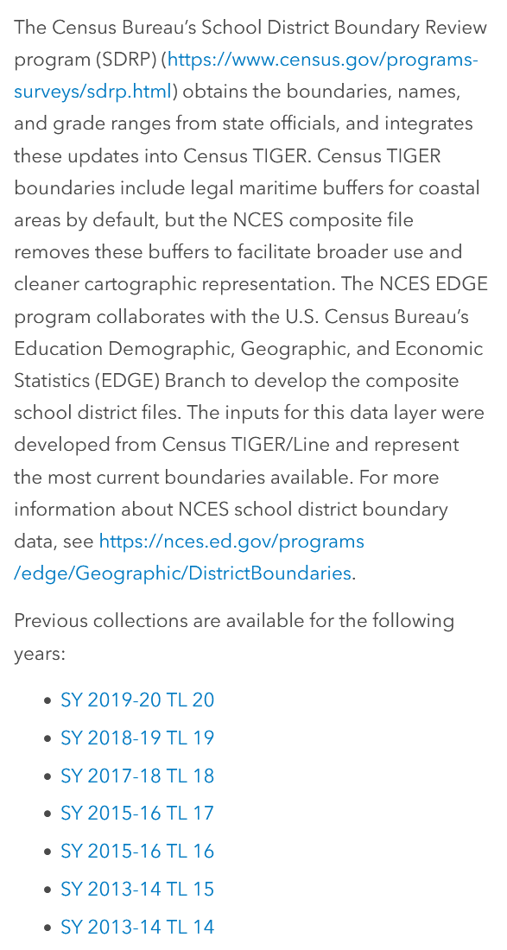
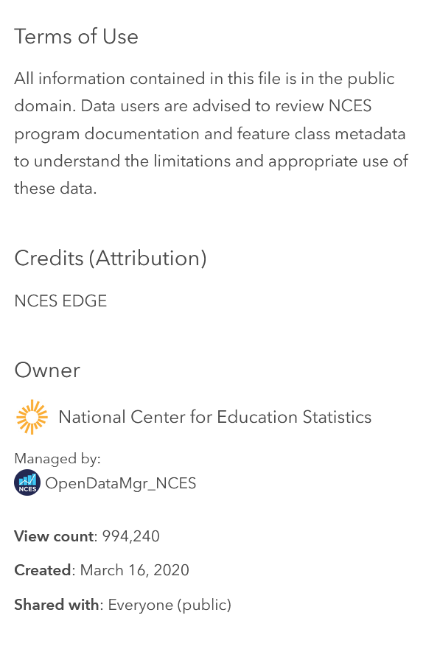
Reading Layers and giving credit
Title
Updated
Description
Terms of Use
Credits (Attribution)
Owner
Managed by
View Count
Created
Shared with

Slide 19
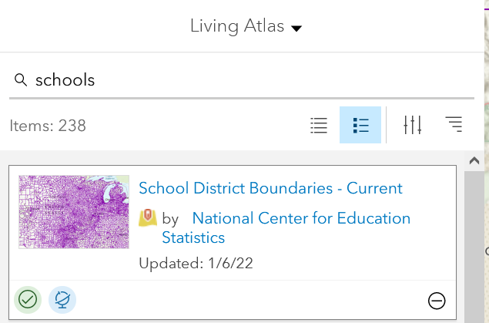
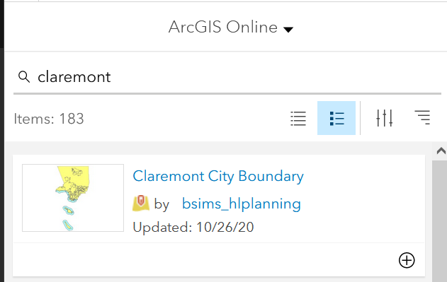
Libraries

Slide 20
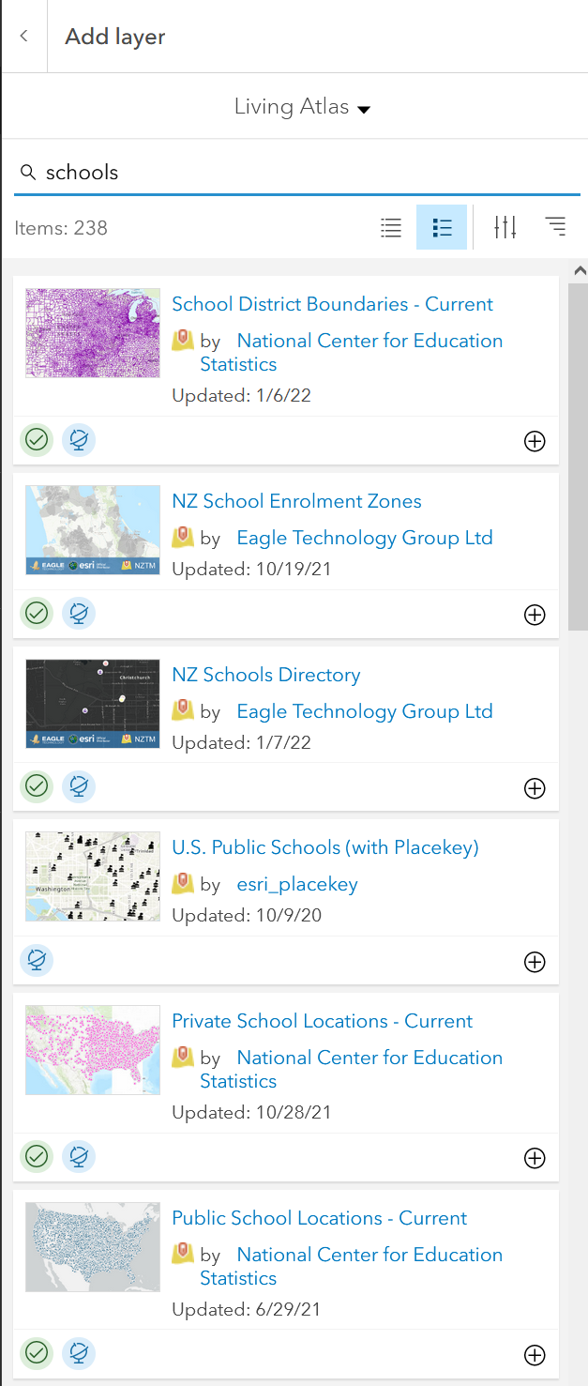


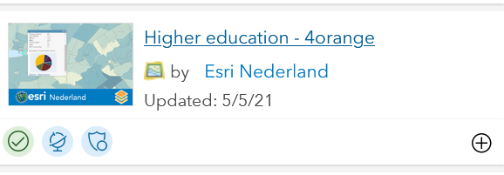
All fun and games till you run out of Credits!!!
Credits vs. Free
Story time! (every GIS specialist has one) The time I blew all my credits on converting all addresses from regular mail to address to geocodes
Addresses vs. Geocodes
latitude versus longitude

Slide 21
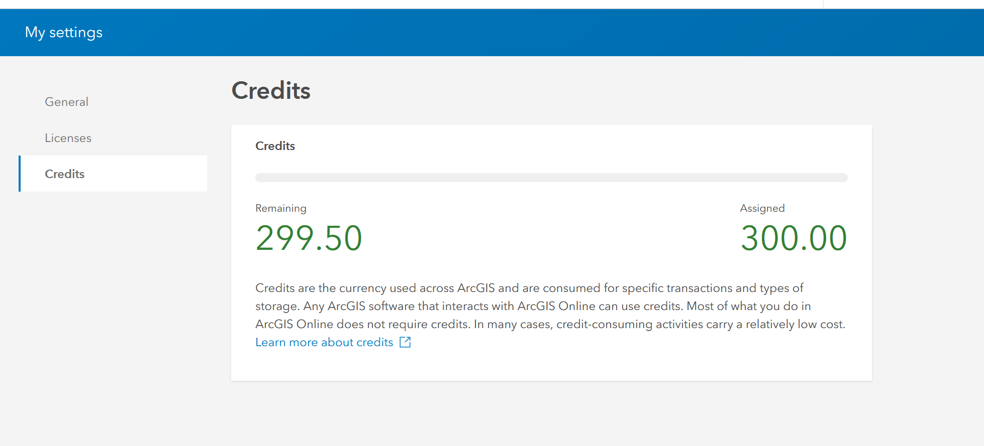
Credits Talk

Slide 22
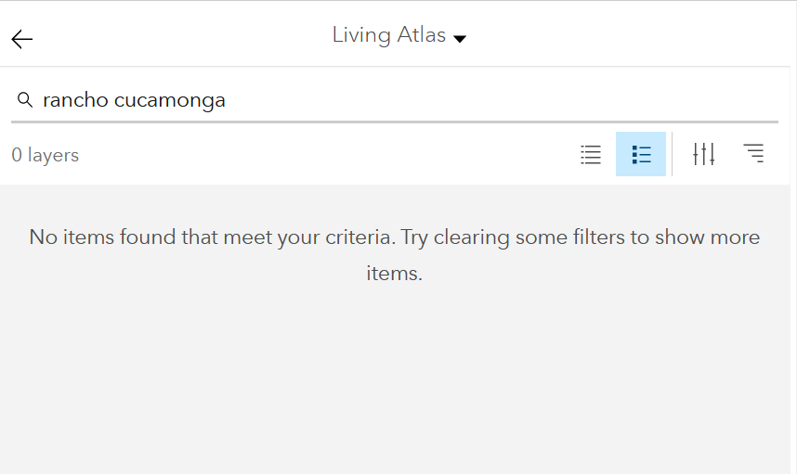
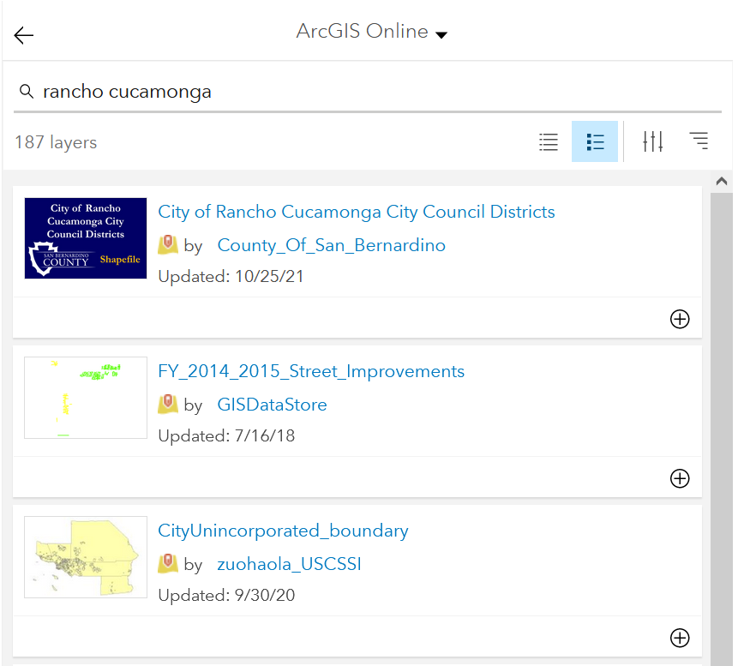
Rancho Cucamonga
Where to live?

Slide 23
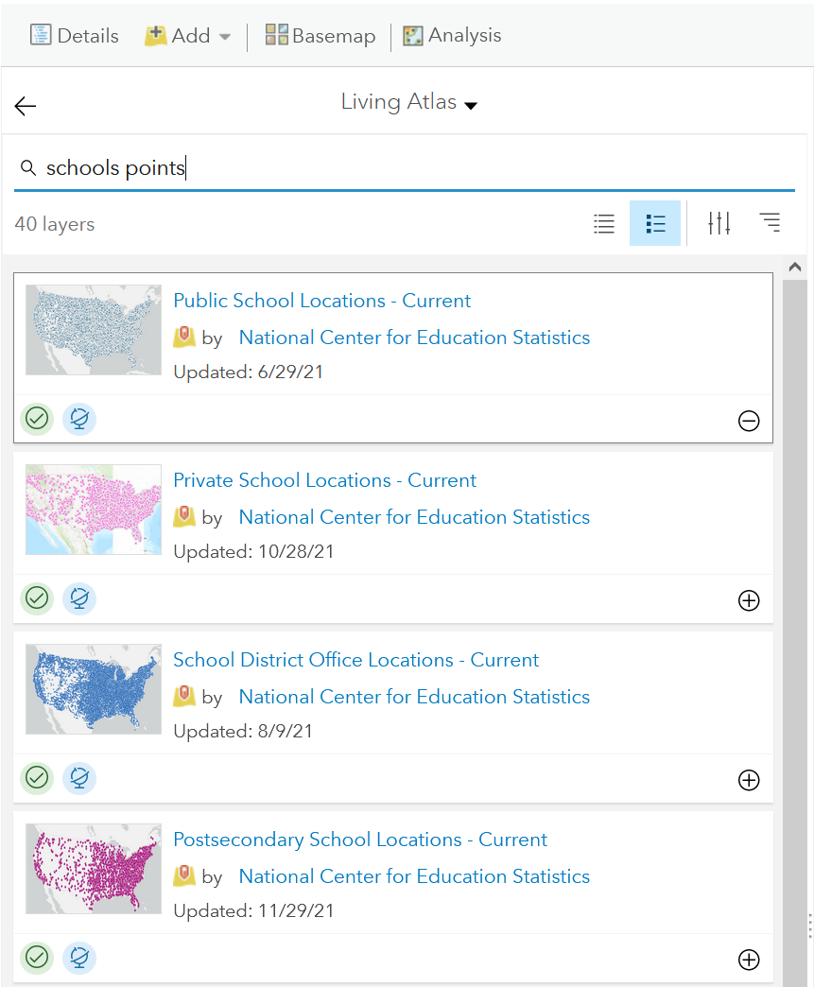
Schools in the area

Slide 24
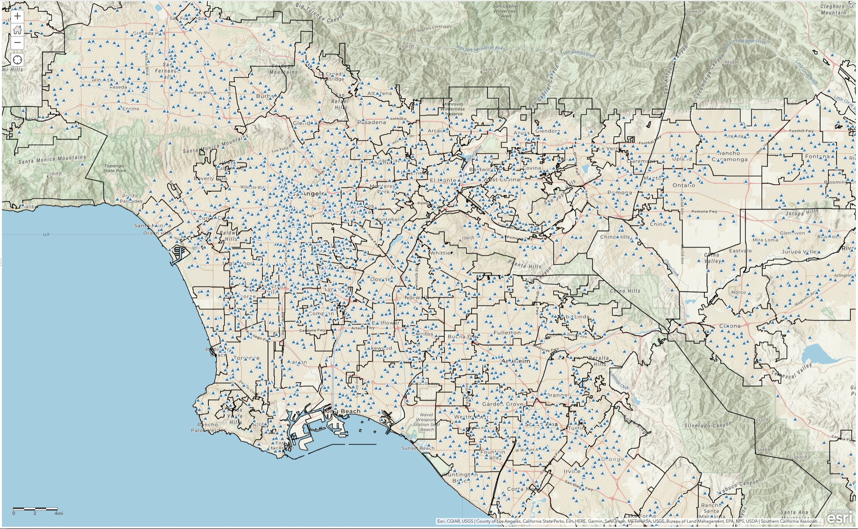
So much information – it hurts my eyes!

Slide 25
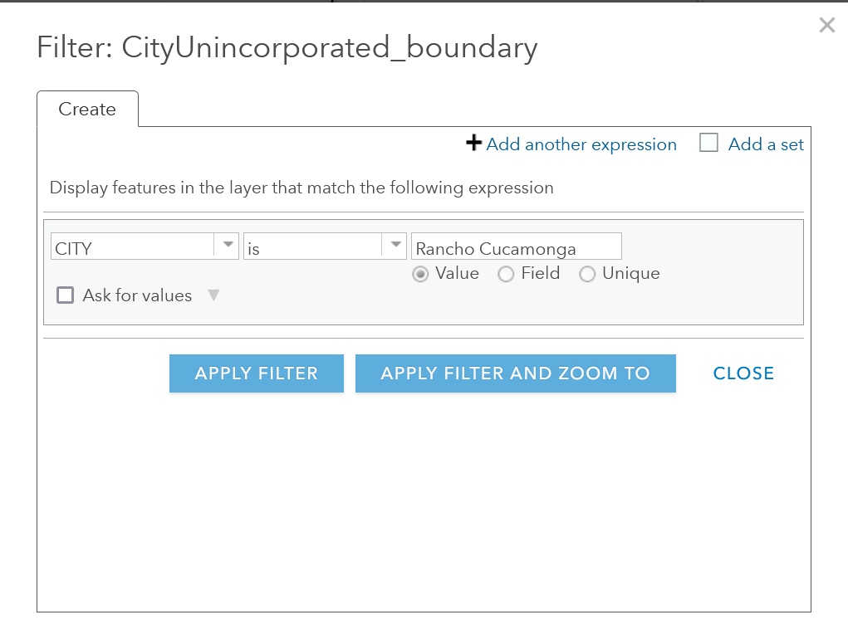
Filter

Slide 26
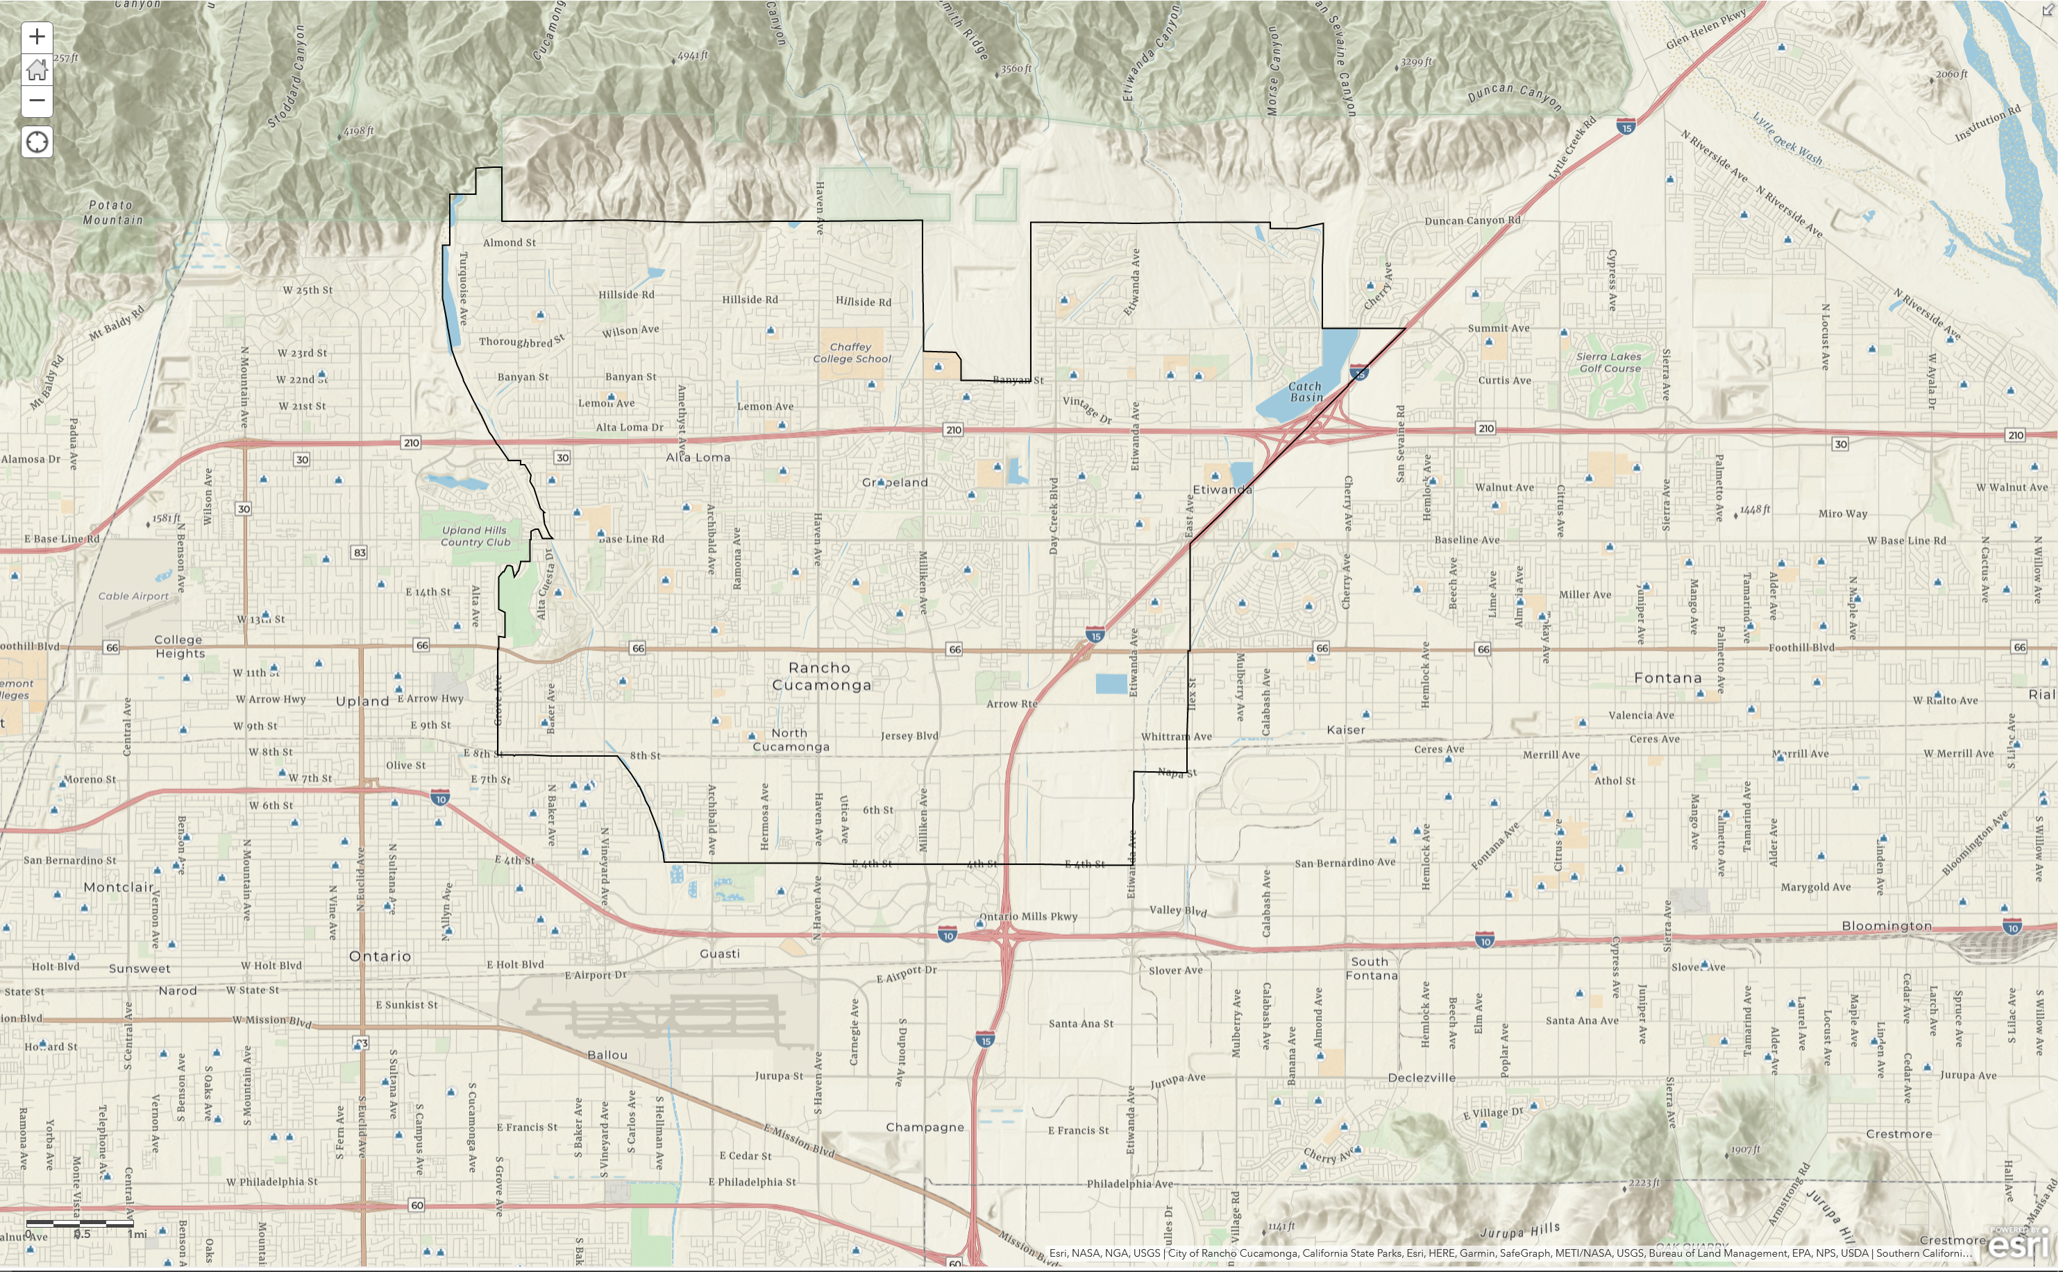
Result

Slide 27
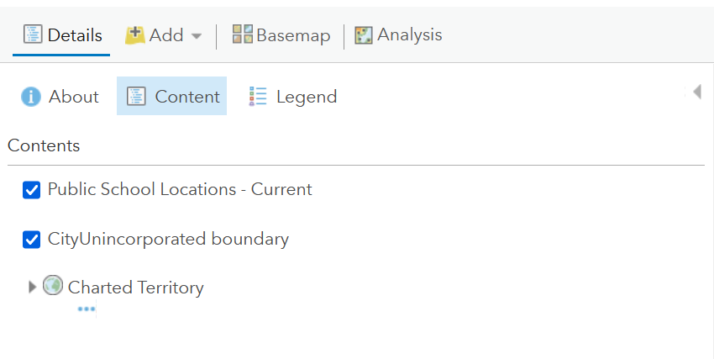
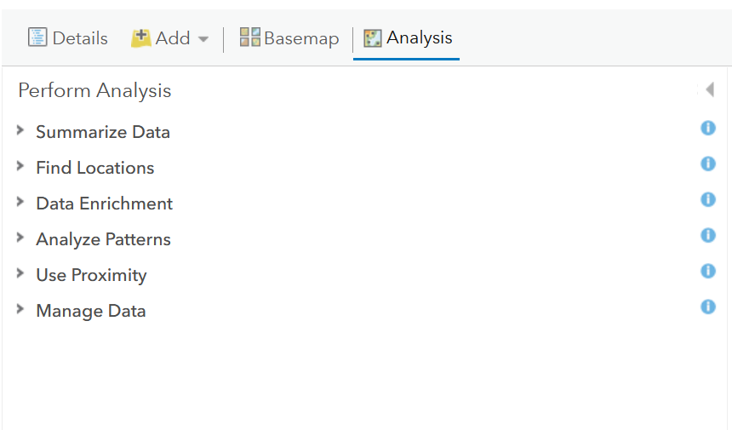
Analysis – Making our own layers

Slide 28
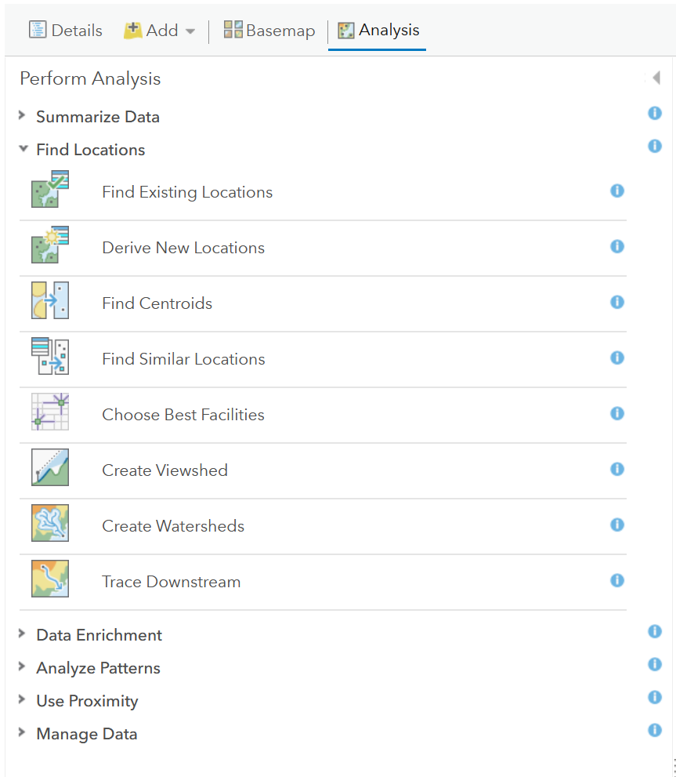
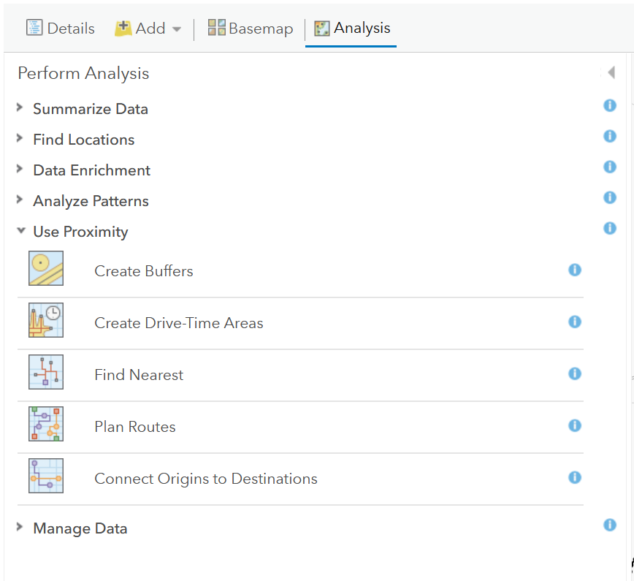
Analysis
Coolest feature in ArcGIS Online – my opinion

Slide 29
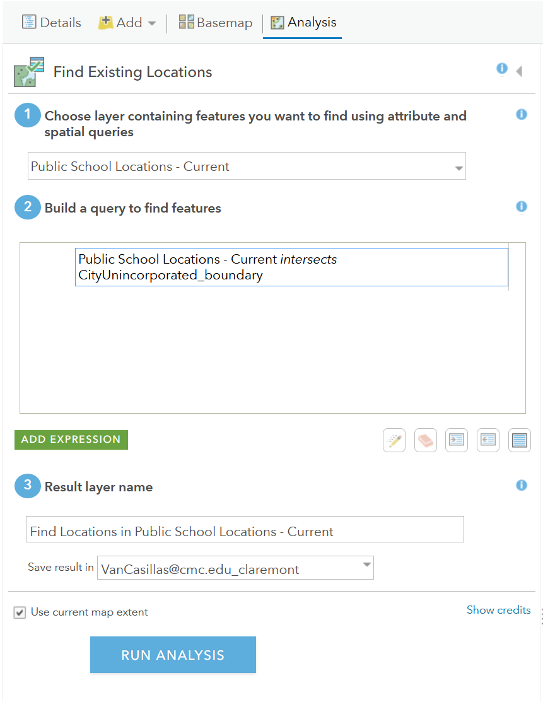
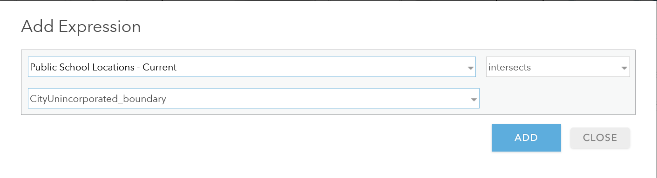
Adding an Expression
Think about what you what to get as a result

Slide 30
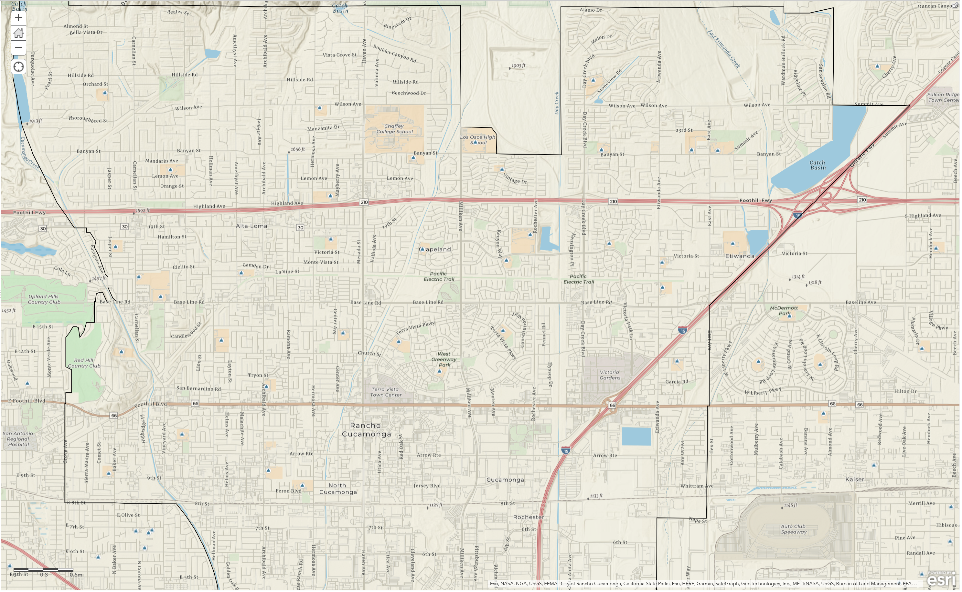

Credits…
Always think of credits

Slide 31
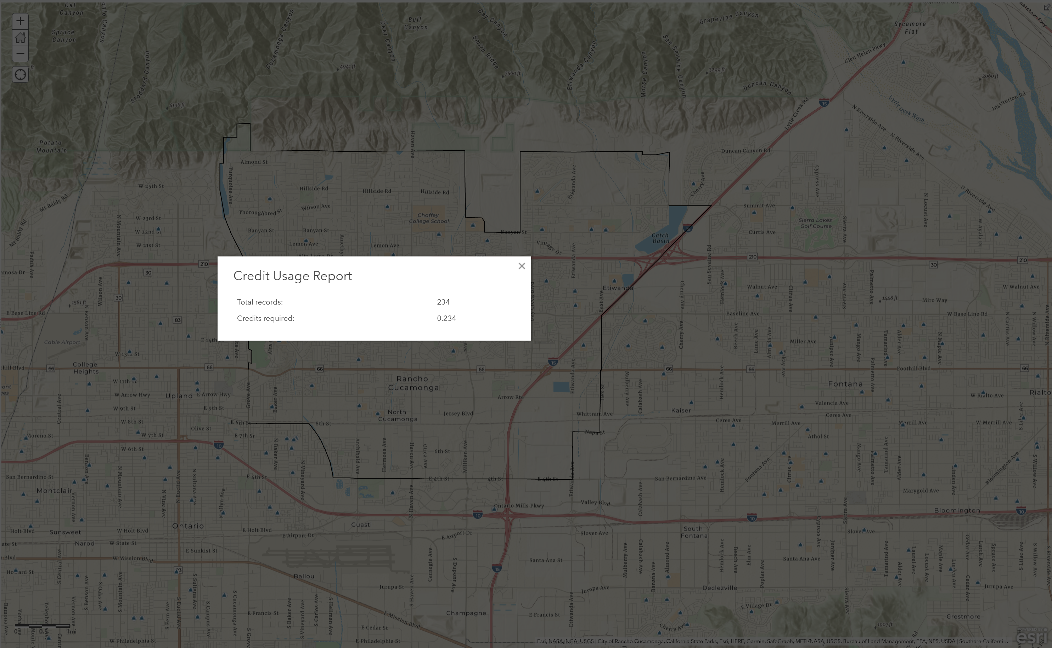
Credits…

Slide 32
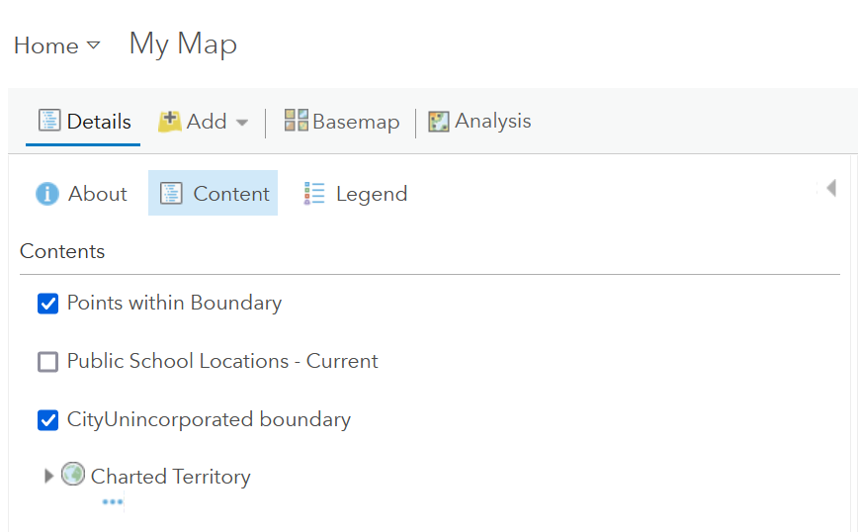
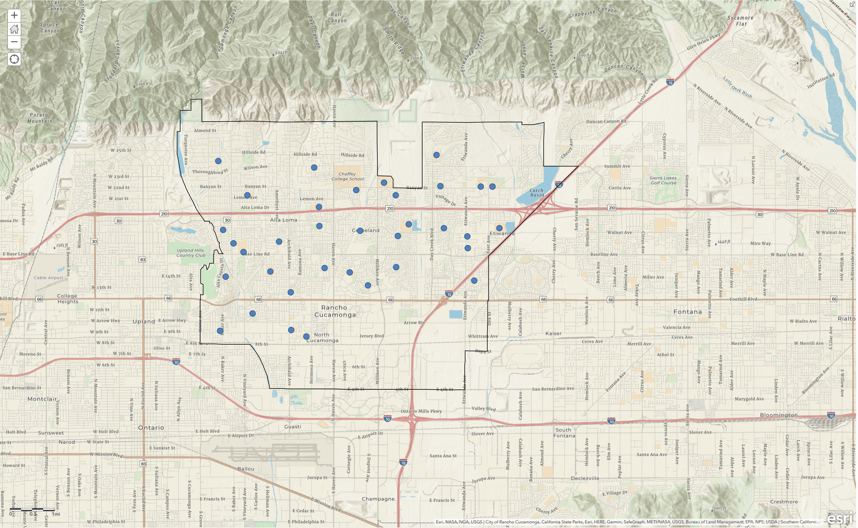
Result
Points on map – so what?

Slide 33
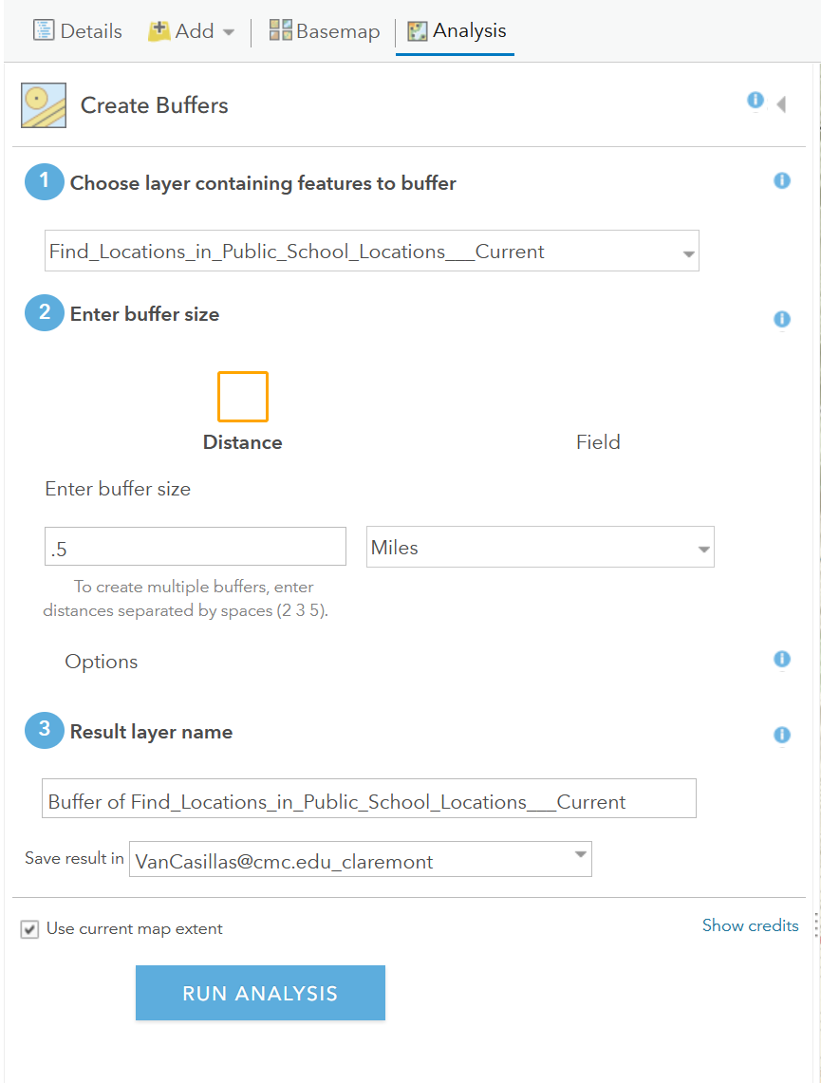
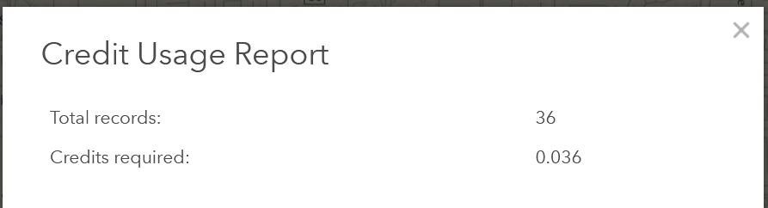
Create Buffers - Analysis

Slide 34
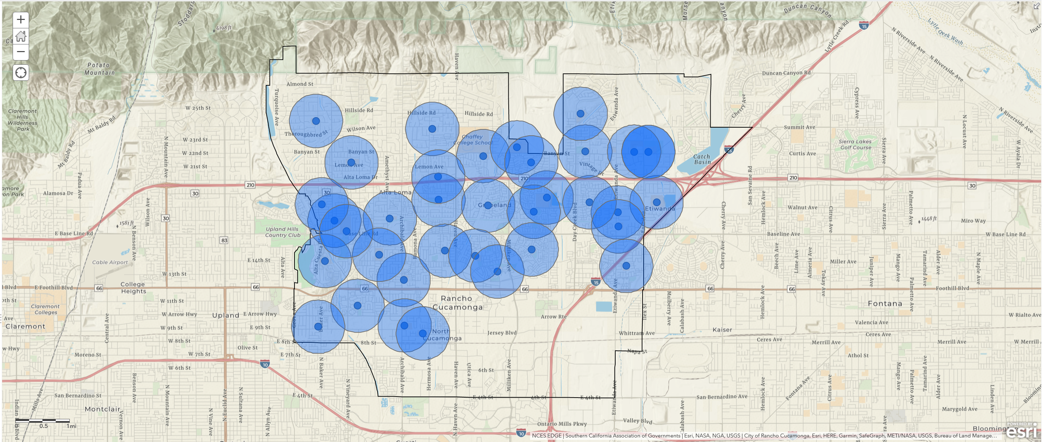
Result

Slide 35
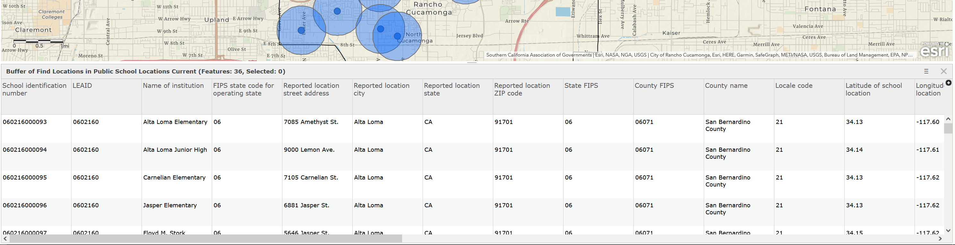
Table – Raw data

Slide 36

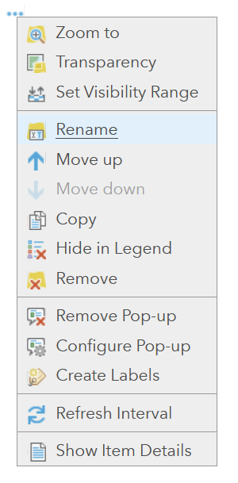
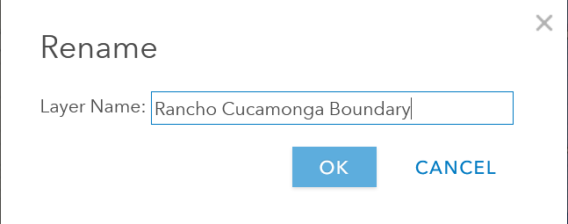
Renaming
Renaming to make more sense to yourself in the future.

Slide 37
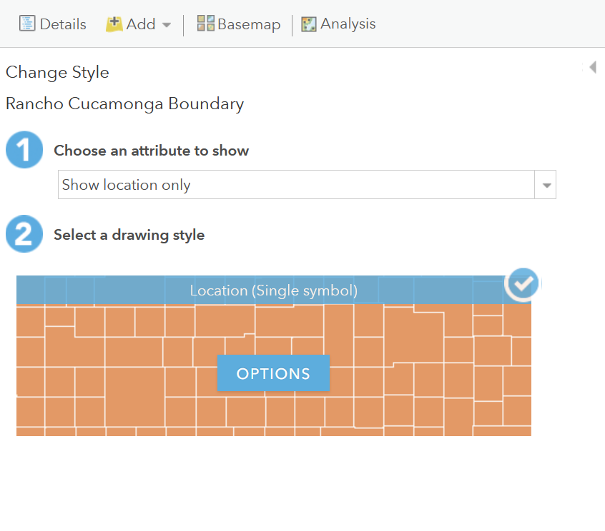
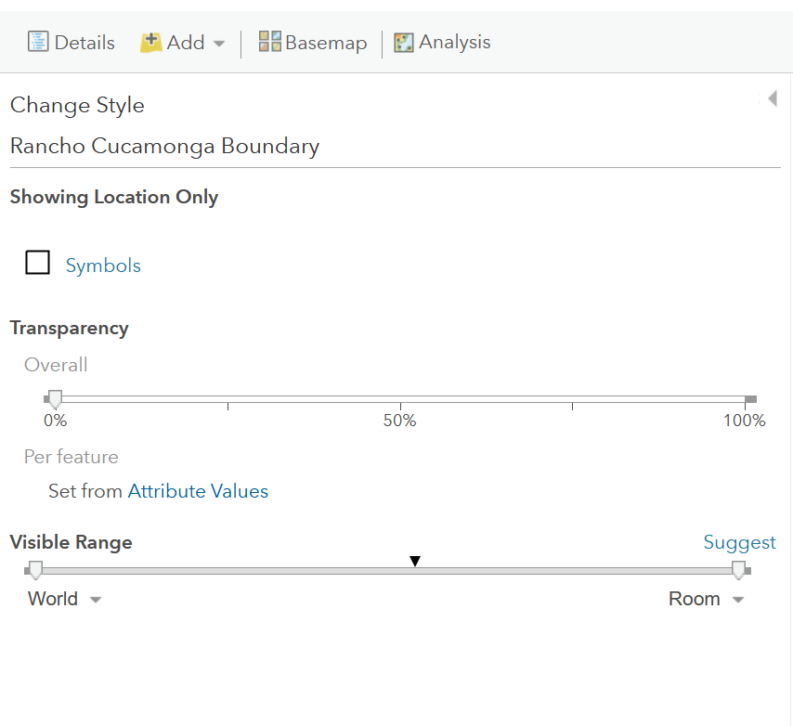
Rancho Cucamonga Boundary Line

Slide 38
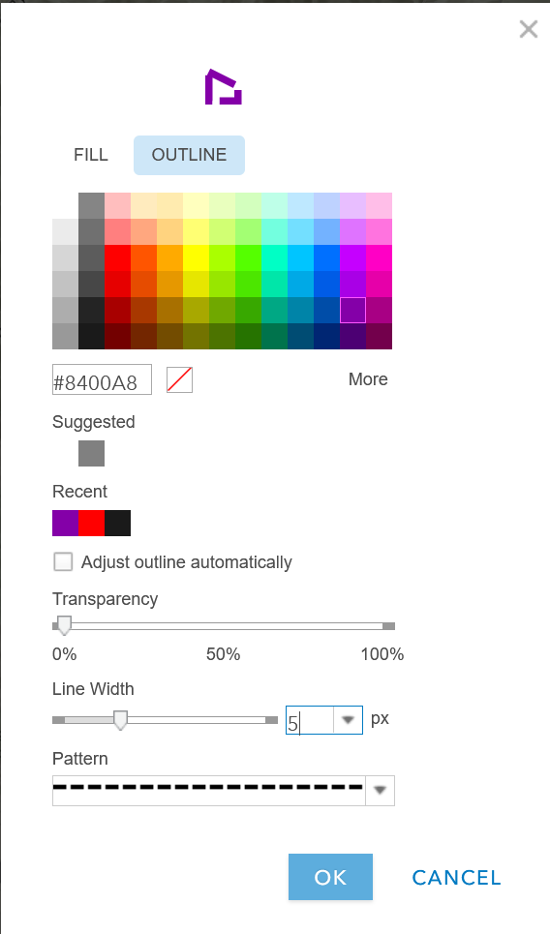
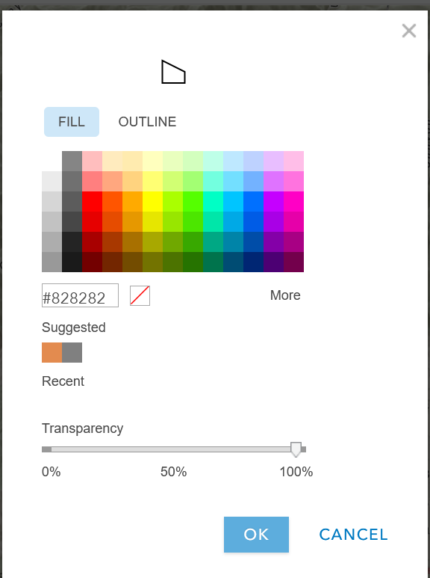
Be Picky
What will catch the eye?

Slide 39



RC Public Schools
Symbols

Slide 40


Default Image
Which will be quick for the eye?

Slide 41



Be Picky
Watch out for your over lapping layers

Slide 42


Moving Layers Around
What is your story?

Slide 43



Create Drive-Time Feature
Make sure to check your credits

Slide 44

A better visual story

Slide 45



Legend and Save

Slide 46

Share

Slide 47

Printing a Map
Go to New ArcGIS Online Map

Slide 49

Edit your Layers Information
Title
Updated
Description
Terms of Use
Credits (Attribution)
Owner
Managed by
View Count
Created
Shared with

Slide 50
Homework – Be Creative
Make a map using the City of Claremont or the Claremont colleges
Share it to the group receive create

Slide 51
GIS 2
Continuing adding to map and looking at features
What makes a good map?
Labels
Colors
Scales
Importing your own data
Cleaning data before import
Having the right information for import
Talk about SQL, Excel and Tables
Charts and Graphs
Exporting into another ESRI program: Story Maps

Slide 52
Resources
ERSI: https://www.esri.com/en-us/home
ArcGIS: https://learn-arcgis-learngis.hub.arcgis.com/

Slide 53
Contact
QCL: QCL@cmc.edu
Vanessa: vanessa.casillas@claremontmckenna.edu

